Slide 1

Dnalytics Assignment
Bank Churn Prediction
A proposal of Machine Learning Calculation of Bank Churn

Slide 2

Table of Contents
Part 1
Problems & Goals
Part 2
Data Understanding
Part 3
Exploratory Data Analysis
Part 4
Machine Learning

Slide 3

What is the Purpose of this Proposal?
To Find out what affect Customer to Churn
What is the target used for this Machine Learning? What Metrics Should we Focus on?
Which type of Customer are more likely to Churn?

Slide 4
Data Understanding
Checking the Dataset
Checking Missing Values
Checking Outliers

Slide 5
Variable Understanding
Numerical
Categorical
Row Number
CustomerID
Credit Score
Age
Tenure
Balance
Estimated Salary
Surname
Gender
NumOfProducts
HasCrCard
IsActiveMember
Exited

Slide 6
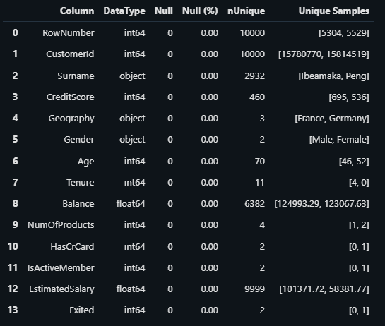
Missing Value
There's no Missing Value Within this Dataset.

Slide 7
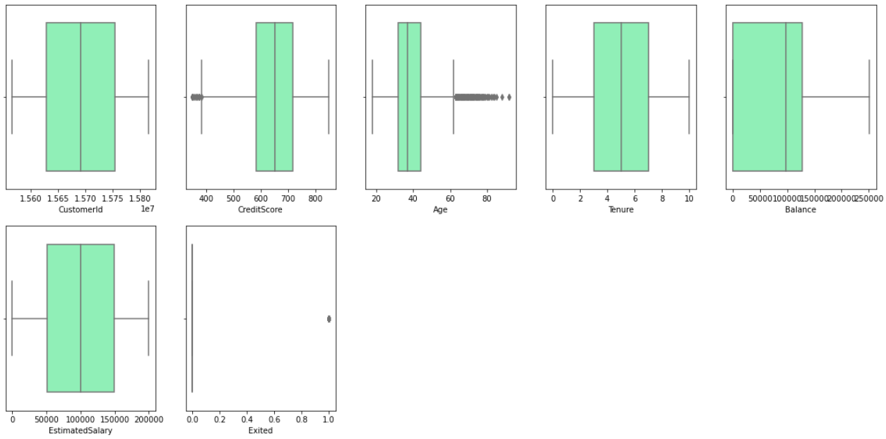
Outliers Using Box Plot

Slide 8
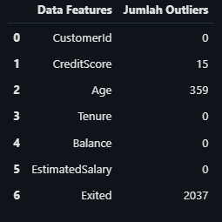
Outliers By Tabular
As we can see there are Outliers in Credit Score, Age, and Exited
For Exited, it can be said that the data obtained are not outliers because the Numbers in Exited variables are 0 and 1
0: Stayed and 1: Churn

Slide 9
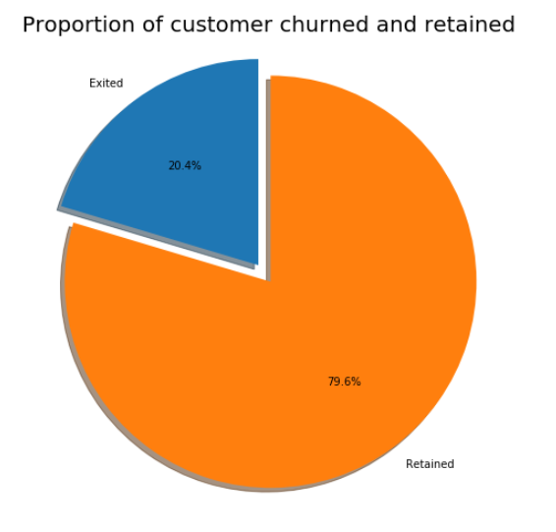
Is the Data Balanced ?
As we can see from the Pie chart, it is shown that the data is Imbalanced.
So in this Project I decide to use Machine Learning Classification on the Model

Slide 10
Exploratory Data Analysis
Quick Feature Engineering
Finding Insights from the Dataset
Checking Corellation

Slide 11
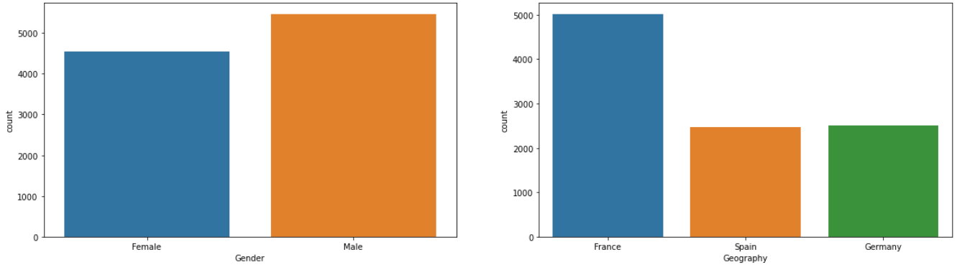
This Bank has more Male Customer compared to Female
Most of the Customer are originated from France
54.5% of the Customers are Male, with total count of 5457
50 % of the Customers are From France, with total count of 5000

Slide 12
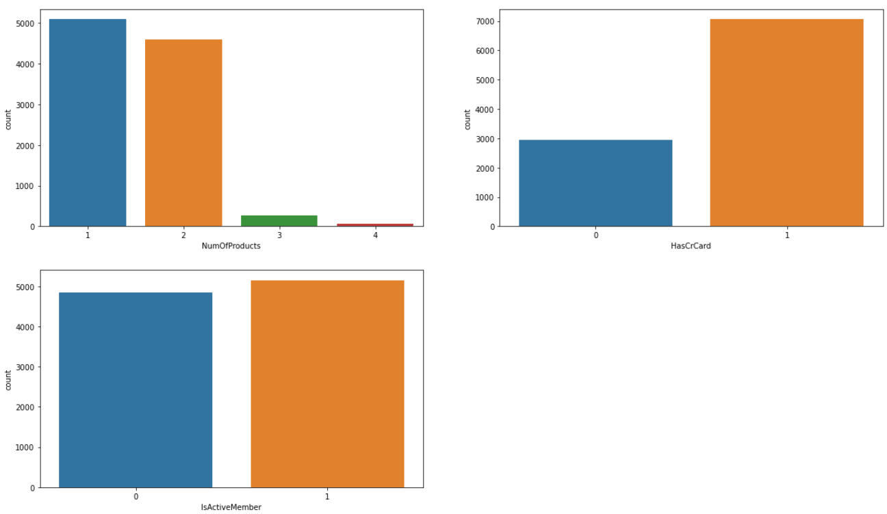
1
Most of our customers are having 1-2 product(s)
About 70% of our customers are having credit cards.
Half of our customers are noted acive member.

Slide 13
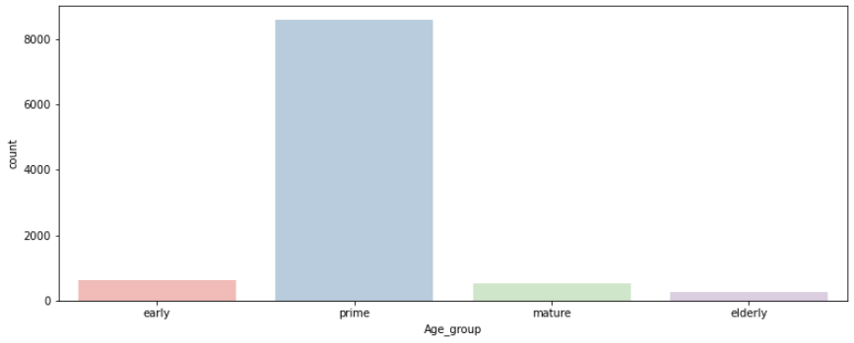
Most of the Customers is on the Prime Working Age which is 25 - 54
85.9% with a total count of 8589

Slide 14
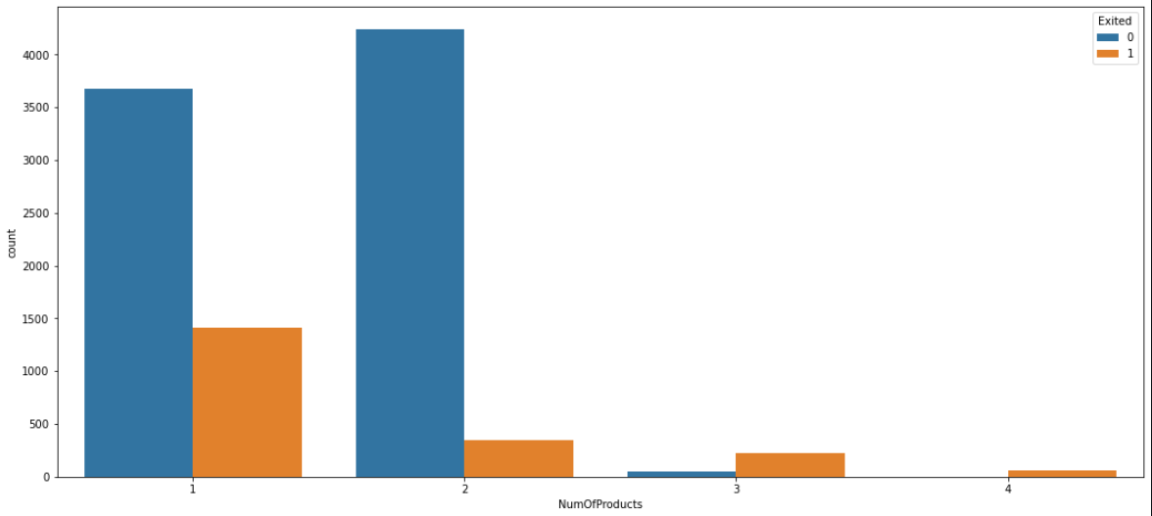
Customer who have more than 2 products are more likely to churn

Slide 15
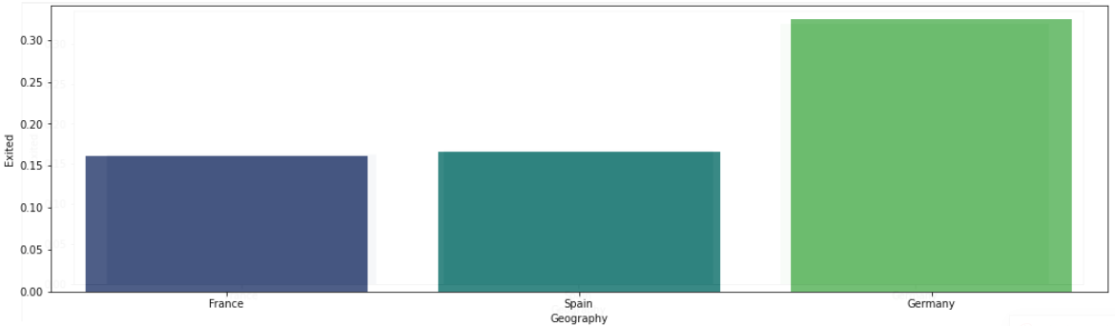
Customers from Germany has the tendency to Churn compared to others

Slide 16
Insights
Only 20.37% of our customers who got the tendency to quit
Most of our customers are in prime Working age (25-54 years old)
Our male customers are slightly higher than our female customers with about 55%
Female has the tendency of Churn than Male
Most of our customers are having 1-2 product(s)

Slide 17
Recommendation
Customers who had more than 2 products are more likely to Churn
Do not offer Customers who have 2 products
Improve Customer Service
The Bank should give extra budget into marketing specifically for Female
Example: Giving Ticket for Holiday, Give Discount on Fashion, etc
Do Customer Survey regarding the Bank
Improve the Digital Section from the Bank
Such as Online Banking, Mobile Banking, Internet Banking
Pay attention more to Germany, because they tend mostly to Churn.
Perhaps can do more special campaigns only for Germany
We should make more interesting and beneficial products targeting our 'Mature working age' class.
Programs made specifically for retirement

Slide 18
Machine Learning
Data Preparation
Feature Engineering & Selection
Encoding
Modeling

Slide 19
Feature Selection
Dropped unwanted variables for Machine Learning, such as Surname, RownumberID, and CustomerID
Do One - Hot Encoding on Gender and Geography variables
Checking Correlation using Correlation Table

Slide 20
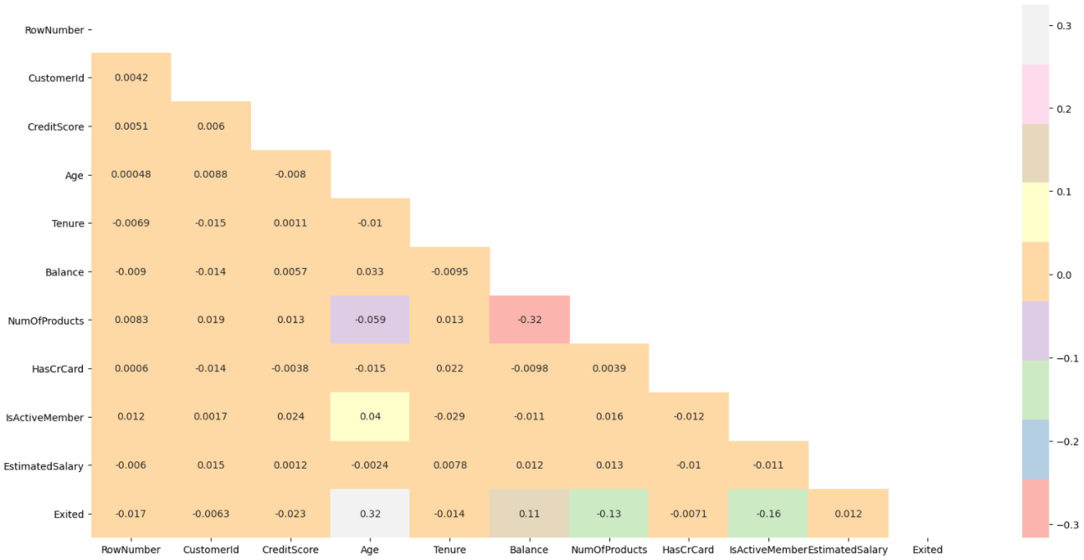

Slide 21
Encoding
Machine learning algorithms require numerical input and output variables.
One Hot Encoding is made to convert Gender and Geography Variable from objects into numerical numbers

Slide 22
Machine Learning Modeling
Splitting Data
Training Model
Choosing Base Model
Hyperparameter Tuning
Confusion Matrix
Conclusion

Slide 23
Machine Learning Modeling
Logistic Regression
K-Nearest Neighbours
Random Forest
XGBoost

Slide 24
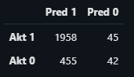
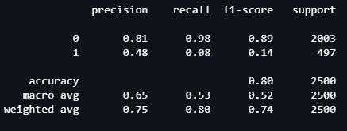
Logistic Regression
Base Model
Confusion Matrix
Classification Report

Slide 25
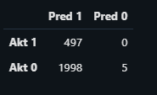
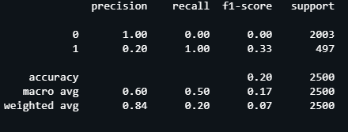
Logistic Regression
Hyperparameter Tuning
Confusion Matrix
Classification Report

Slide 26
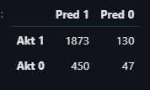
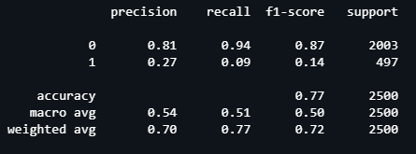
K-Nearest Neighbours
Confusion Matrix
Classification Report

Slide 27
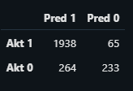
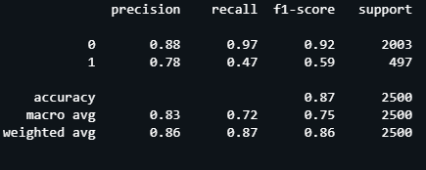
Random Forest
Base Model
Confusion Matrix
Classification Report

Slide 28
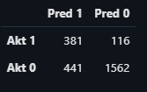
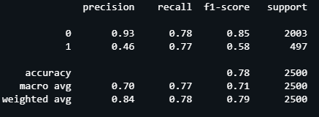
Random Forest
Hyperparameter Tuning
Confusion Matrix
Classification Report

Slide 29
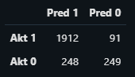
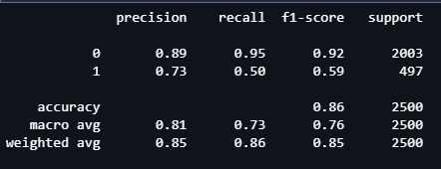
XGBoost
Base Model
Confusion Matrix
Classification Report

Slide 30
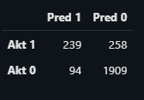
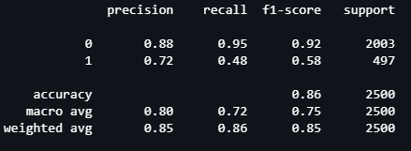
XGBoost
Hyperparameter Tuning
Confusion Matrix
Classification Report

Slide 31
Conclusion
To sum up, the Best Model for this Dataset is Base Random Forest.
Recall Score 0.97
False Positive 264
False Negative 65
False Positive is Customers who predicted will Churn but they do not
False Negative is Customers who predicted not to Churn but they do

Slide 32
Simulation
It is known that the cost of acquiring a new customer is 5 times the cost of retaining an existing customer.
To make a simple calculation, I made a simple simulation.
Create a customer retention program, for customers who are predicted to churn
For example: Giving 1 Honda Beat (with the value of IDR 18.000.000) for customers who are predicted will Churn with 3 years contract agreement.
Calculations are made that, to retain existing customers will cost IDR 18.000.000, but to acquire or lose 1 customer will cost IDR 90.000.000

Slide 33
Simulation without using Model
The total number of Customers in this Dataset is 10,000 people
20.4% of The total Customers are Churned (2040 people)
To do Rough Calculation, using the same simulation made
The Business Loss is 2040 * 5 * 18.000.000
Which Equal to IDR 183 Billion

Slide 34
Simulation Using ML Model
Base Random Forest Model have Recall Score of 0.97
Rough Calculations is made
97% of 2040 is 1978.8
This means the remaining Customers who are predicted Churn but remain stayed in the Business is 61.2 people
Round the total of Churn Customers into 61
Business Loss for this case is 61 * 5 * 18.000.000
IDR 5.490.000.000 which is significantly lower compared to Simulation without using ML Model

Slide 35
Simulation Using ML Model
False Positive : 264
False Negative : 65
Total Business Loss = FP + FN
FP = 264 * 18.000.000 = IDR 4.752.000.000
FN = 65 * 5 * 18.000.000 = IDR 5.850.000.000
Total Business Loss is IDR 10.602.000.000
Which is significantly lower compared to Simulation without using Machine Learning Model

Slide 36
Source
Dataset taken from: https://www.kaggle.com/santoshd3/bank-customers
Reference:
https://www.fpsc.com/the_cost_of_customer_churn.pdf
https://www.investopedia.com/terms/c/credit_score.asp
https://www.tigeranalytics.com/blog/addressing-customer-churn-in-banking/

